Slide 1
Strong Method Problem Solving
Expert System Technology
Rule-Based Expert Systems
Model-Based, Case-Based and Hybrid Systems
Planning

Slide 2
Expert Systems
Knowledge intensive method
Expert systems take advantage of expertise of human domain experts
Human expertise as heuristics
  Support inspection of reasoning processes, presenting intermediate steps and answering questions about the solution process
  Allow easy modification in adding and deleting skills from KB
  Reason heuristically, using knowledge to get useful solutions

Slide 3
Expert System Features
Rich KB and easy modification
Open reasoning process
Explanation of reasoning
Exploratory prototyping
Heuristic reasoning (problem-solving)
Wide range applications
  Interpretation – from raw data to conclusion
  Prediction – weather
  Diagnosis – medical, mechanical
  Design – CAD, Civil
  Planning – scheduling, Robot
  Monitoring – Inspector
  Instruction – CAE, online learning
  Control – production line control

Slide 4
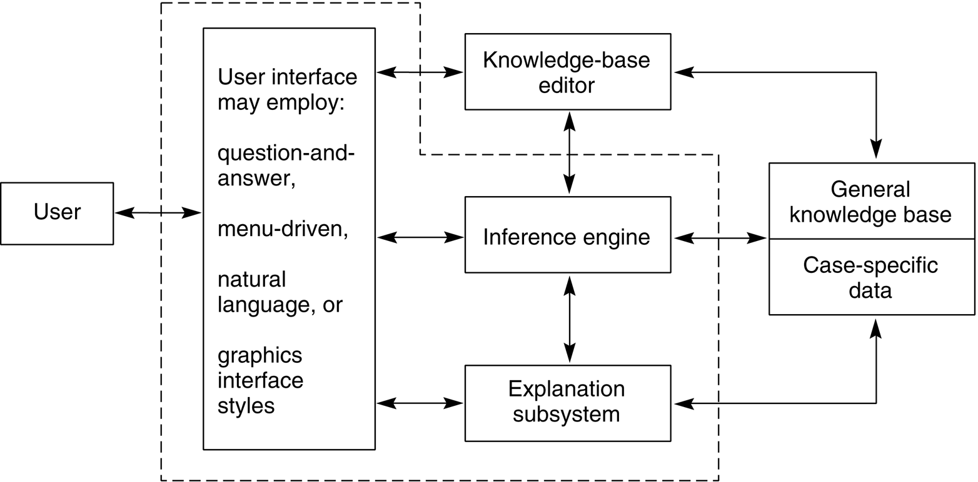
Architecture of Expert Systems
Architecture of a typical expert system for a particular problem domain.

Slide 5
Modules of Expert Systems
User interface
  simplify communication and hide much of the complexity, such as the internal structure of the knowledge base
Knowledge base
  Domain knowledge
  General knowledge and case-specific information
  Optional KB editor
Inference engine
  Reasoning mechanism to apply the knowledge to the solution of problems
  E.g. recognize-act control cycle in production systems
Explanation subsystem
  Allow the program to explain its reasoning to the user, to justify the conclusion
  Respond to why and how queries

Slide 6
Separation Knowledge Base from Inference Engine
Represent knowledge in a more natural fashion
Builders can focus on capturing and organizing domain knowledge
Modularization, easy to maintain – modification, addition, removal, etc
Build expert system shell that can be provided with different domain knowledge to form different ES

Slide 7
Selecting Problems for ES
Guidelines to determine whether a problem is appropriate for expert system solution:
The need for the solution justifies the cost and effort of building an expert system.
Human expertise is not available in all situations where it is needed.
The problem may be solved using symbolic reasoning.
The problem domain is well structured and does not require commonsense reasoning.
The problem may not be solved using traditional computing methods.
Cooperative and articulate experts exist.
The problem is of proper size and scope.

Slide 8
Roles in Building ES
Knowledge engineer
  AI language and representation expert
  Select software and hardware, acquire and organize knowledge in a specific form
Domain expert
  Professionals
  Provide knowledge of the application area
End user
  Specify requirements and constraints
  Test and verify the product

Slide 9
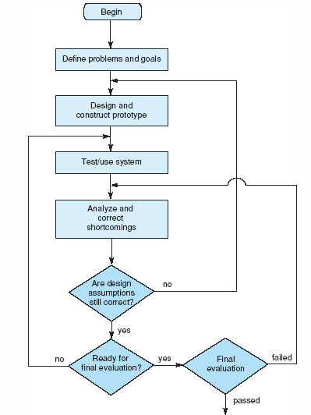
ES Exploratory Development Cycle
ES Programming
  Prototyping development
  Unlimited maintenance

Slide 10
Knowledge Acquisition
Acquire expertise (domain knowledge) from domain experts
Characteristics of domain expertise
  Inaccessible -- Perceptible but non-describable
  Free format
  Vague, imprecise, and bias
  Dynamic (change)

Slide 11
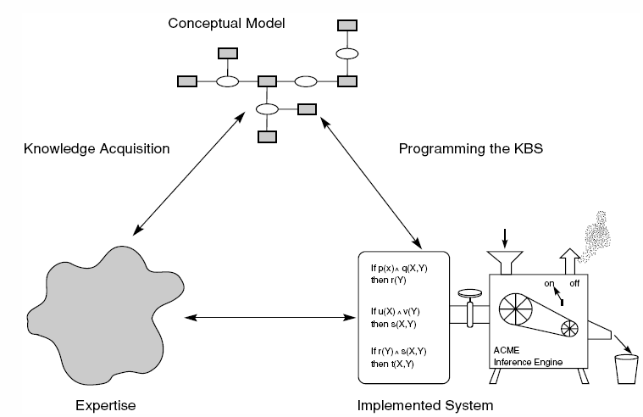
Knowledge Engineering
Engineering process
  Knowledge acquisition
  Knowledge representation
  System implementation
  System maintenance
Conceptual Model
  Intermediate representation of domain knowledge, like ER diagram in DB design

Slide 12
Rule-Based Expert Systems
Features
  Knowledge base organized as a set of if … then … rules
  Lead to the ES architecture
  Natural
  Widely used
Production system vs. Rule-based ES
  Similarity: both use rules
  Production system is a special case of rule-based systems: production Condition → Action can be considered as if Condition then Action
  Differences: Production systems implement graph search with either goal-driven or data-driven strategy, while rule-based ES implements logical reasoning

Slide 13
A Production System
A small expert system for analysis of automotive problems.
Rule 1:
if the engine is getting gas,
and
the engine will turn over,
then
the problem is spark plugs.
Rule 2:
If the engine does not turn over,
and
the lights do not come on
then
the problem is battery or
cables.
Rule 3:
If the engine does not turn over,
and
the lights do come on
then
the problem is the starter motor.
Rule 4:
If there is gas in the fuel tank,
and
there is gas in the carburettor
then
the engine is getting gas.

Slide 14
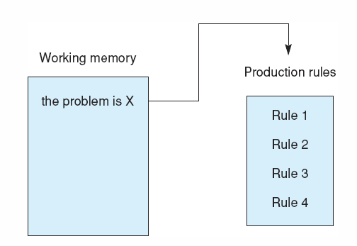
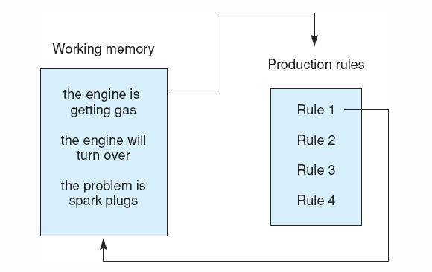
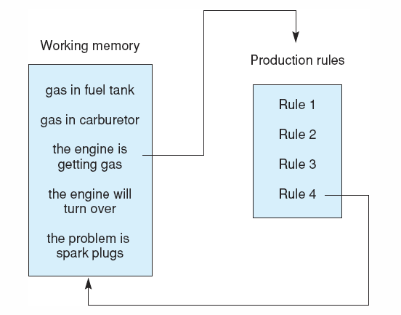
Goal-Driven Problem Solving
The production system at the start
The production system after Rule 1 has fired.
The system after Rule 4 has fired.
Note the stack-based approach to goal reduction
Depth-first search

Slide 15
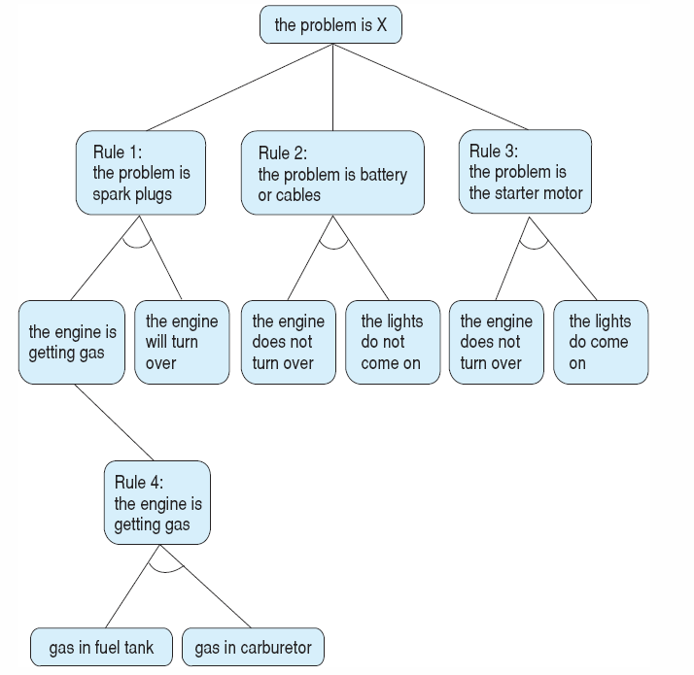
The and/or graph searched in the car diagnosis example, with the conclusion of Rule 4 matching the first premise of Rule 1.

Slide 16
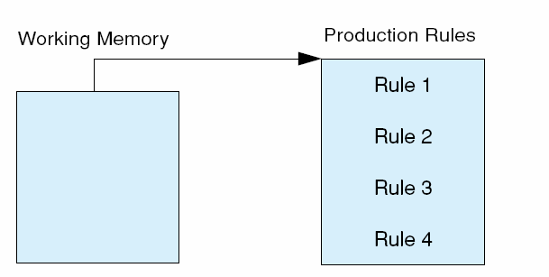
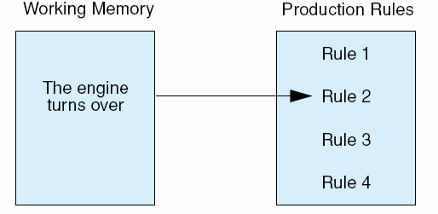
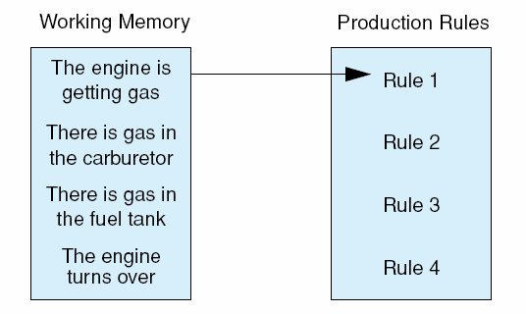
Data-Driven Problem Solving
The production system at the start.
The production system after evaluating the first premise of Rule 2, which then fails.
The data-driven production system after considering Rule 4, beginning its second pass through the rules.
Breadth-first search

Slide 17
Explanations in ES
Two general questions to be answered by rule-based ESs: Why and How
Explanation in goal-driven reasoning
  Why
    When the system asks the user for information and the user responds “why to ask”
    The answer is the current rule
  How
    When the system conclude a solution and the user asks “how to conclude”
    The answer is the sequence of rules that have been used
Explanation in data-driven reasoning
  Less-focused on search
  Limited explanation

Slide 18
Explanation in Goal-Driven Reasoning
Gas in fuel tank?
Yes
Gas in carburetor?
Yes
Engine will turn over?
Why
It has been established that:
1. The engine is getting gas,
2. The engine will turn over,
Then the problem is the spark plugs.
How the engine is getting gas
This follows from rule 4:
if
gas in fuel tank, and
gas in carburetor
then
engine is getting gas.
gas in fuel tank was given by the user
gas in carburetor was given by the user
The following dialogue begins with the computer asking the user about the goals present in working memory.

Slide 19
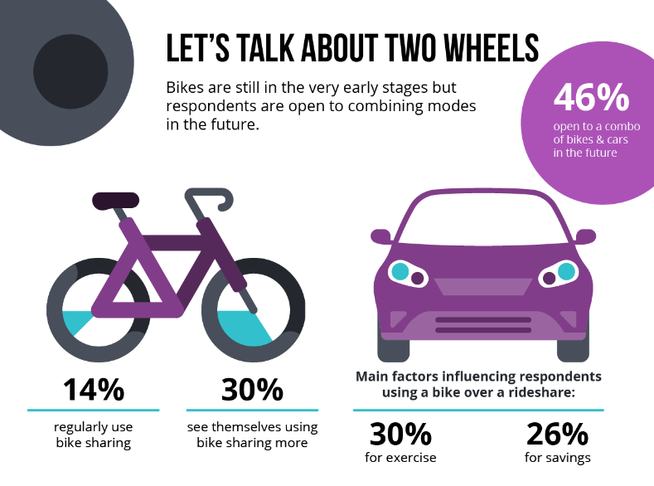
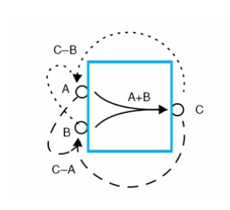
Model Based Reasoning
An inference method used in expert systems based on a model of the physical world.
The main focus of application development is developing the model.
Then at run time, an "engine" combines this model knowledge with observed data to derive conclusions such as a diagnosis or a prediction.
In a model-based reasoning system knowledge can be represented using causal rules.

Slide 20
Model-based reasoning
Development of a bicycle-sharing program for a city.
Model Creation: City transportation infrastructure, including existing bike lanes, road networks, public transportation routes, and population distribution.
Alternative Designs: Include different placement strategies for bike stations, variations in the number and types of bikes available, and pricing models for usage.
Simulation and Analysis: Simulate designs considering factors such as the demand for bikes at different times of day, the impact on traffic congestion, the accessibility of bike stations to different neighbourhoods, and the potential environmental benefits.
Evaluation and Decision-Making: Evaluate the strengths and weaknesses of each design option such as user convenience, cost-effectiveness, environmental sustainability, and social equity.
Implementation: Select most promising design for the bicycle-sharing program and work on its implementation involves securing funding, coordinating with city agencies and private partners, and conducting public outreach and education campaigns.

Slide 21
Case-Based Reasoning
CBR is the process of solving new problems based on the solutions of similar past problems.
An auto mechanic who fixes an engine by recalling another car that exhibited similar symptoms is using case-based reasoning.
A lawyer who advocates a particular outcome in a trial based on legal precedents or a judge who creates case law using case-based reasoning.
Consider a movie recommendation system like Netflix.
  When a user logs in, the system retrieves similar users' past viewing habits and recommends movies or TV shows based on those similarities.
  If a user enjoys action movies and science fiction, the system might recommend a new release that falls into these categories.
  As the user watches and rates movies, the system learns more about their preferences and can refine its recommendations over time.

Slide 22
Case-based reasoners share a common structure
For each new problem they:
  Retrieve appropriate cases from memory.
  Modify a retrieved case so that it will apply to the current situation
  Apply the transformed case
  Save the solution, with a record of success or failure, for future use

Slide 23
The storage and retrieval of cases.
Kolodner (1993)
Goal-directed preference. Organize cases, at least in part, by goal descriptions. Retrieve cases that have the same goal as the current situation
Salient-feature preference. Prefer cases that match the most important features or those matching the largest number of important features
Specify preference. Look for as exact as possible matches of features before considering more general matches
Frequency preference. Check first the most frequently matched cases
Recency preference. Prefer cases used most recently Ease of adaptation preference. Use first cases most easily adapted to the current situation.

Slide 24
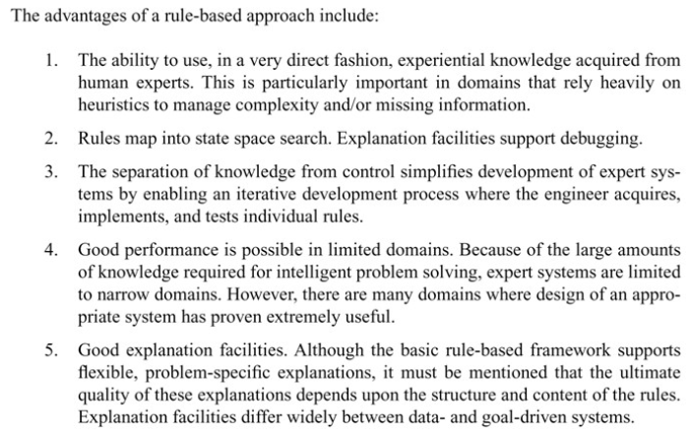

Slide 25
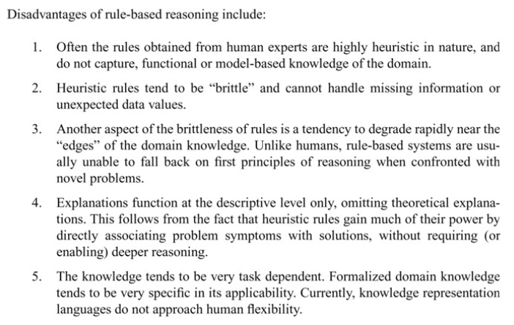

Slide 26
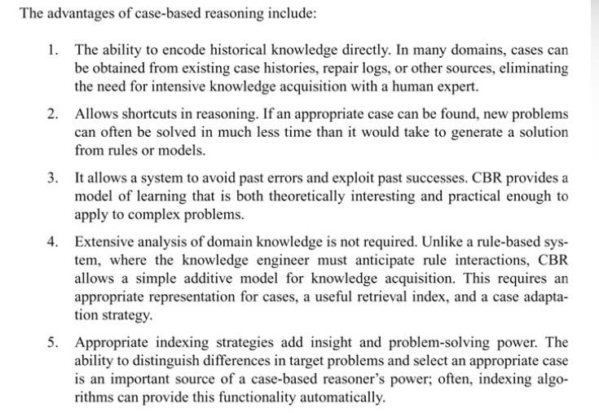

Slide 27
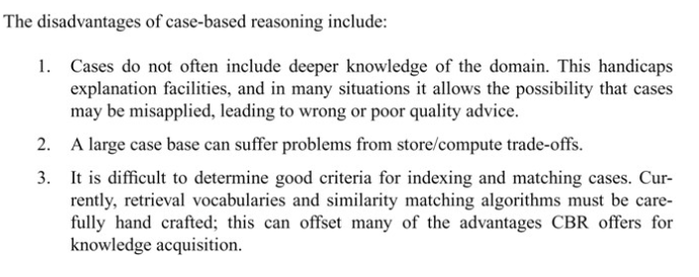

Slide 28
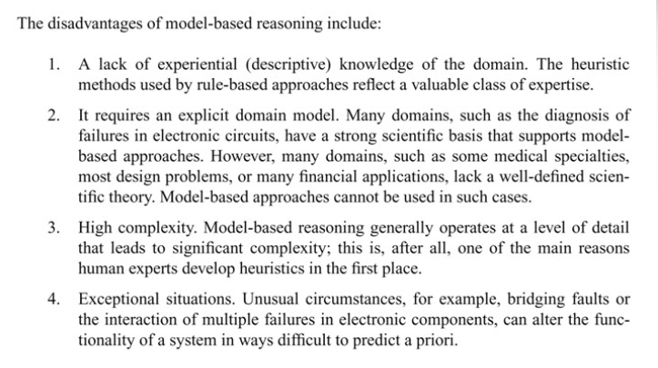

Slide 29
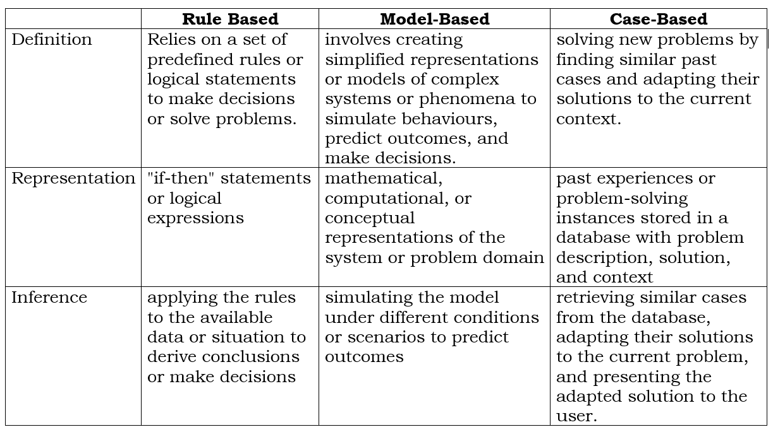

Slide 30
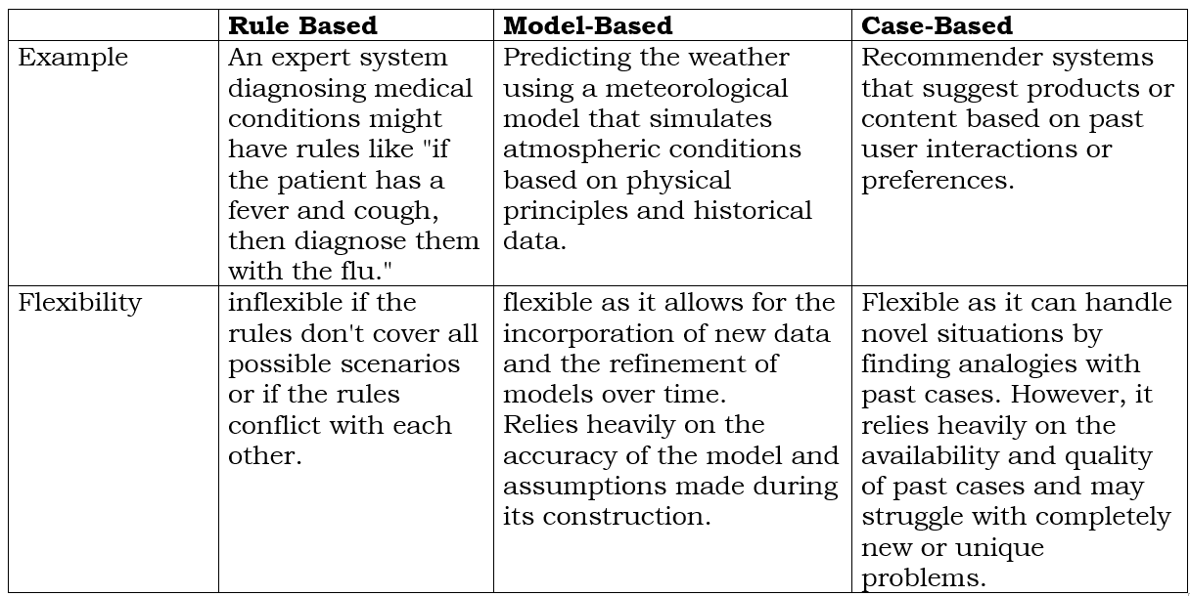

Slide 31
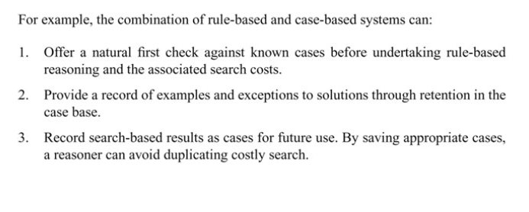
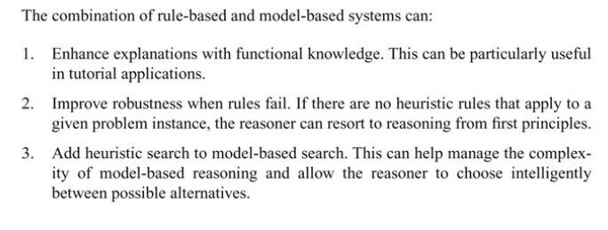

Slide 32
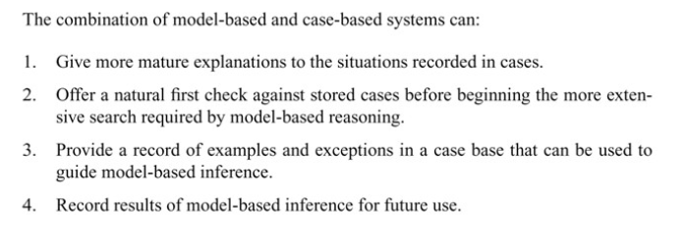

Slide 33
Planning
Find a sequence of actions to accomplish some specific task
Knowledge intensive
  Organize pieces of knowledge and partial plans into a solution procedure
Applications
  Robotics
  Expert systems in reasoning about events occurring over time
  Process control, monitoring
  Natural language understanding where discussing plans, goals, and intentions

Slide 34
Robotics
A plan is a set of atomic actions that are domain-dependent
Block world robot
  atomic actions may be
    Pick up an object a
    Go to location x
  Task: go get block a from room b
  A plan:
    Put down whatever is now held
    Go to room b
    Go over to block a
    Pick up block a
    Leave room b
    Return to the original location
Planning is to search through a space of possible actions to find the sequence necessary to accomplish the task

Slide 35
Issues of Planning
State description of the world
  Possible states
  Atomic actions
  Effect of actions on the world
State transition
  Which part changed
  Which part unchanged
  Frame problem: specification of exactly what is changed by performing an action on the world
Generating, saving, optimizing plans
Generalizing plan
Recovering from unexpected plan failure
Maintaining consistency between the world and the system internal model of the world

Slide 36
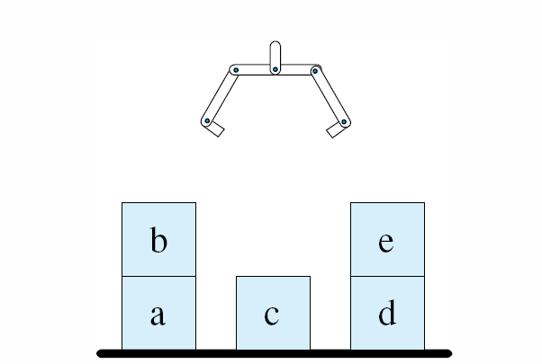
The Blocks World
The blocks world consists of 5 blocks, 1 table, and 1 gripper (hand).

Slide 37
Atomic Actions
Goto(X, Y, Z)
  go to location (x, y, z)
  This location might be implicit in pickup(W) where block W has location (X, Y, Z)
Pickup(W)
  pickup and hold block W from the current location
  The block is clear on top, the gripper is empty, and the location of block W is known
Putdown(W)
  place W at the current location on the table
  W must be held
  Record the new location for W.
Stack(U, V)
  place U on top of V
  The gripper must be holding U, and V is clear on top
Unstack(U, V)
  remove U from the top of V
  U must be clear of other blocks, V must have U on top of it, and the gripper must be empty

Slide 38
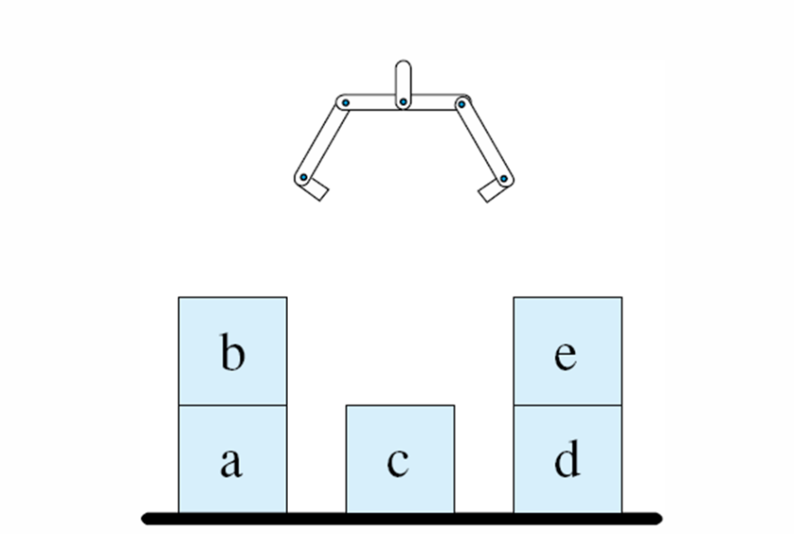
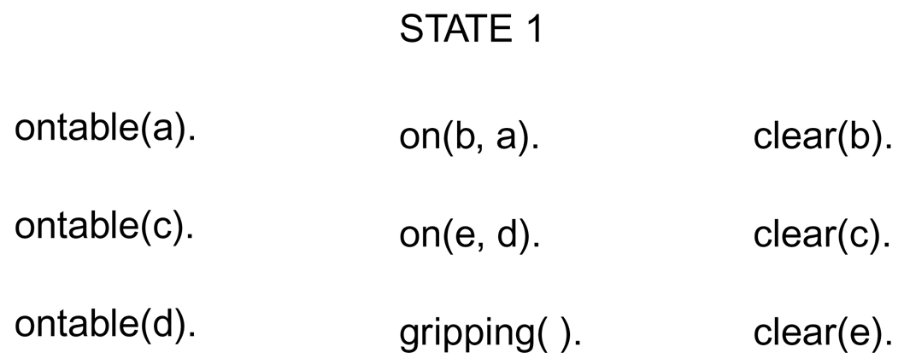
State Representation
A set of predicates and predicate relationships
location(W, X, Y, Z): block W is at (X, Y, Z)
on(X, Y): block X is immediately on top of block Y
clear(X): block X has nothing on top of it
gripping(X): the robot arm is holding block X
gripping(): the gripper is empty
ontable(W): block W is on the table
Initial state

Slide 39
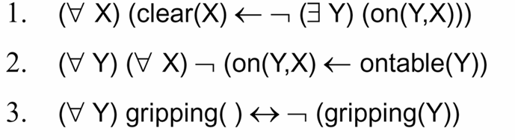
A number of truth relations or rules for performance are created for the clear (X), ontable (X), and gripping( ).
Rules can be interpreted either logically or procedurally. Consider the first rule.
  Logic interpretation: If block X is clear, there does not exist any block Y such that Y is on top of X. Initial state
  Procedural interpretation: to clear X, go and remove any state Y that might be on top of X

Slide 40
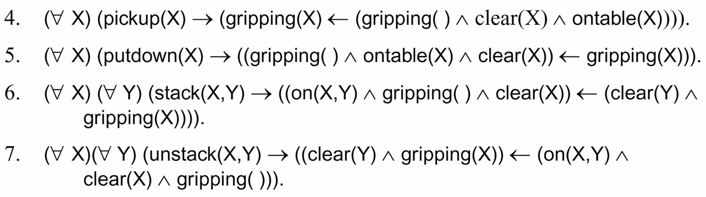
Rules to operate on states and produce new states:
A→ (B← C) means that A produces B when C is true
Consider Rule 4:
  For all blocks X, pickup(X) means gripping(X) if the hand is empty (gripping nothing) and X is clear.

Slide 41
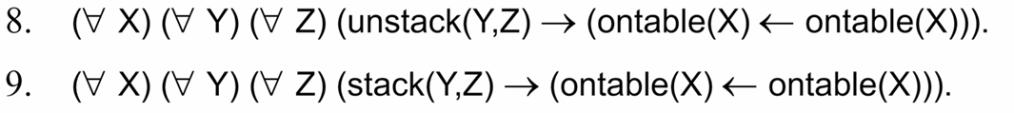
Frame rules (axioms) to describe what predicates are not changed by rule applications and thus carried over the new states
These two rules say:
  ontable is not affected by the stack and unstack operators
May have other frame axioms such as:
  on and clear are affected by stack and unstack operators only when that particular on relation is unstacked or when a clear relation is stacked
  Thus, on(b, a) is not affected by unstacked(c, d)

Slide 42
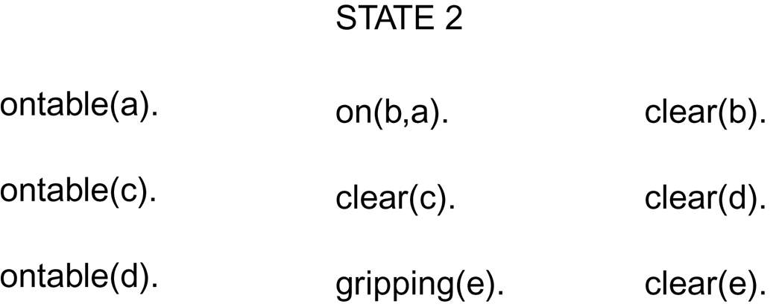
New State
Operators and frame axioms define a state space
New state by applying the unstack operator and the frame axioms to the nine predicates of the initial state: STATE 1

Slide 43
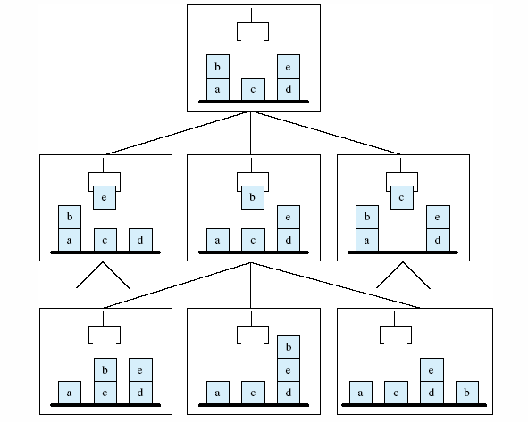
Portion of the state space for blocks world

Slide 44
STRIPS
STRIPS – Stanford Research Institute Planning System (now SRI International)
Drove the SHAKEY robot (1970s)
Addresses:
  Efficiently represent and implement the operations of a planner
  Resolve conflicting subgoals
  Provide a learning model: save and generalize successful plans as macro operators for the future use
Data structure: triangle tables for organizing and store macro operations

Slide 45
Triangle Tables
Data structure for organizing sequence of actions, including potentially incompatible subgoals
Relates the pre-conditions to post-conditions (combined add and delete lists)
Used to determine when a macro operator could be used
  A macro operator is a sequence of primitive operations that perform a subgoal
  the problem of conflicting subgoals within macro actions by representing the global interaction of sequences of operations
Save macro operators and reuse them in the future plane
  Reuse macro operators to solve the problem of conflicting subgoals

Slide 46
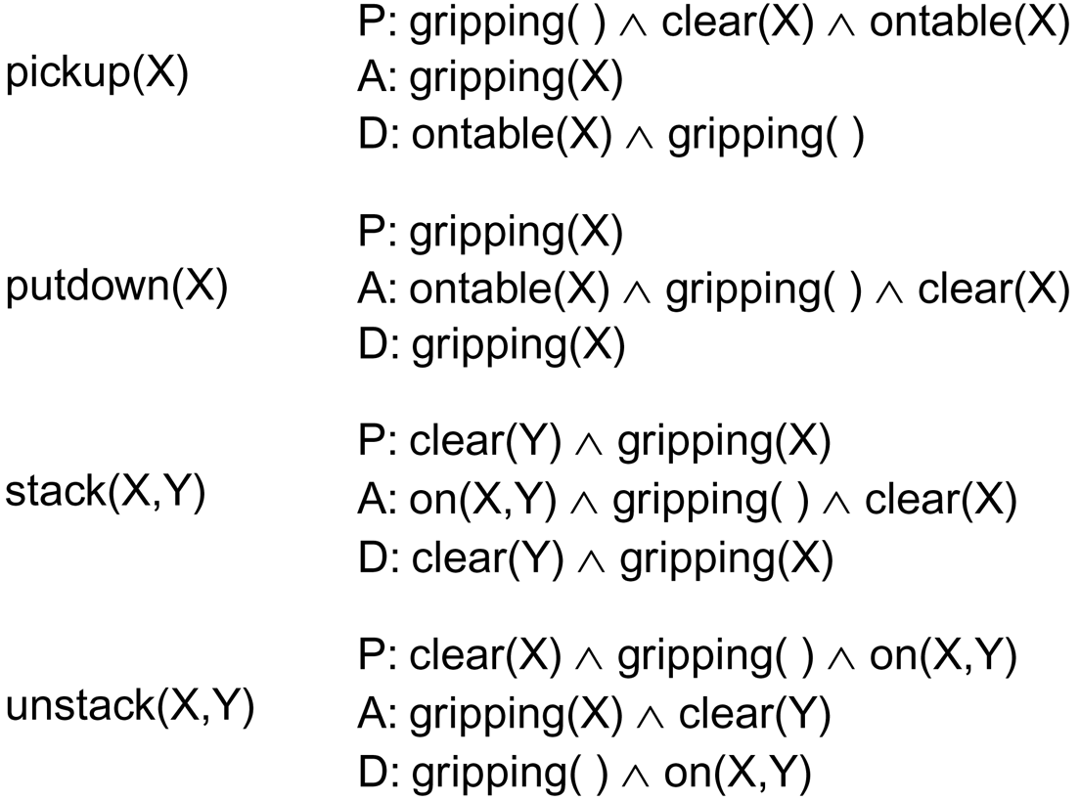
STRIPS on Blocks World
Four operators pickup, putdown, stack, and unstack
Precodition-Add-Delete approach
  P – Precoditions that must be met for the operator
  A – Add list to add states that are the result of the operator
  D – Delete list to delete items that are removed from a state or create the new state when the operator is applied

Slide 47
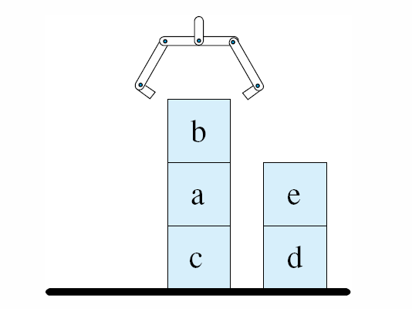
Consider the following goal. on(b,a)∧on(a,c) is part of the goal. On(b, a) is true in both states, but must be undone.
If the planner has developed a plan for the subgoal of the form stack(X, Y)∧stack(Y, Z), it does not need to break the goal into subgoals and avoids the complications
Initial state
Goal state

Slide 48
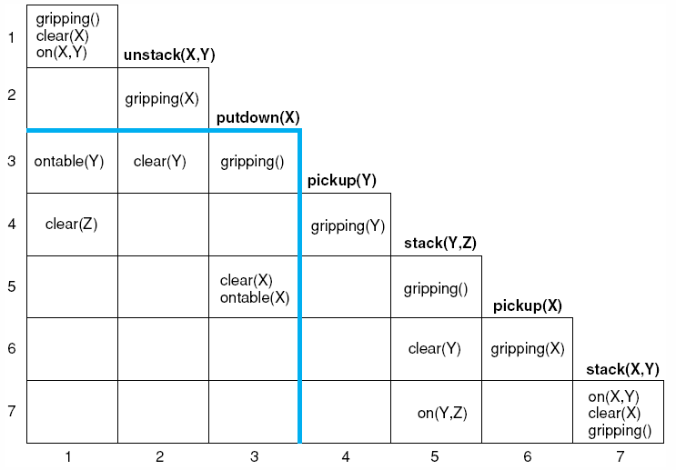
A triangle table of the blocks world

Slide 49
Summarization on Planning
Planning may be seen as a state space search
New states are produced by general operators such as stack and unstack plus frame rules
The techniques of graph search may be applied to find a path from the start state to the goal state. The operators on this path constitute a plan

